Slide 1
You Don’t Need to be a Genius or Visionary or even a College graduate to be successful. You just need a framework and Dream. - Michael Dell

Slide 2
PHP MVC FRAMEWORK
MENTOR : Mr. Gourav sharma
Ashish kumar DEEPAK CHOPRA
06425602714 06325602714

Slide 3
INTRODUCTION
PHP MVC Framework
PHP MVC is an application design pattern that separates the application data and business logic (model) from the presentation (view). MVC stands for Model, View & Controller.
The controller mediates between the models and views.
Think of the MVC design pattern as a car and the driver.
The car has the windscreens (view) which the driver (controller) uses to monitor traffic ahead then speed or brake (model) depending on what he sees ahead.

Slide 4

The model is the central component of the pattern. It expresses the application's behaviour in terms of the problem domain, independent of the user interface. It directly manages the data, logic and rules of the application.
A view can be any output representation of information, such as a chart or a diagram. Multiple views of the same information are possible, such as a bar chart for management and a tabular view for accountants.
The third part or section, the controller, accepts input and converts it to commands for the model or view

Slide 5
OBJECTIVE
Creating a MVC framework that can provide a fast structure and functionality to a web application.
This framework can improve the overall development period of the project as well as the overall security of the project.
Features :-
Time efficient and is easy to update.
It is easy to understand the whole structure.
Faster development.
Easy to troubleshoot.
Easy deployment to web servers.

Slide 6
EFFECTIVENESS
This Project isolates the business logic from the user interface, with the goal of creating applications that are easier to manage and maintain because designers can modify the underlying business rules with fewer harmful effects.
It separates input, processing, and output of an application. The project consist of Model, View & Controller all of them are built to handle some specific development aspects of any web or software application.
Increased developer productivity, this is because the base implementation of activities such as connecting to the database, sanitizing user input etc. are already partially implemented.

Slide 7
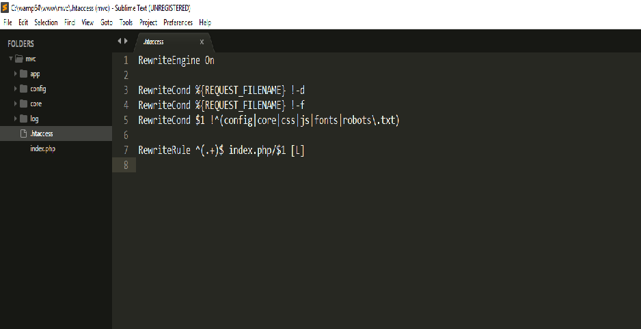
PROJECT SCREENSHOTS
Apache server code that works before every request

Slide 8
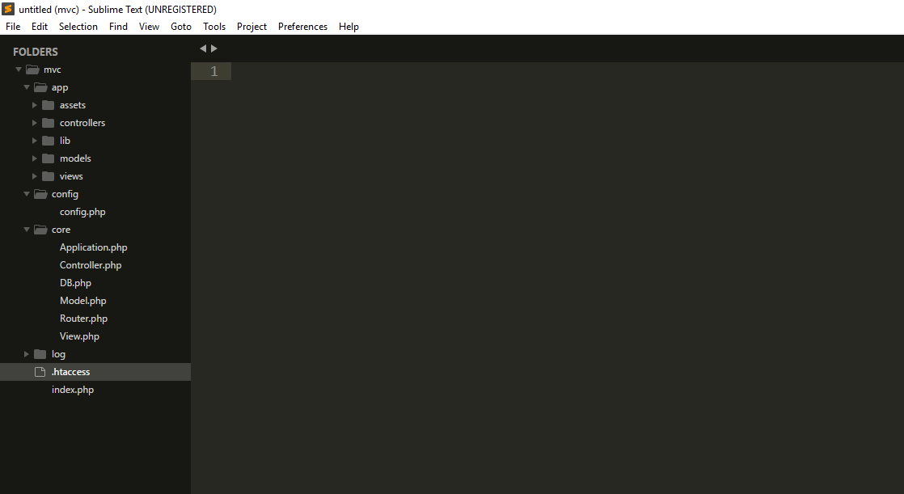
Directory Structure

Slide 9
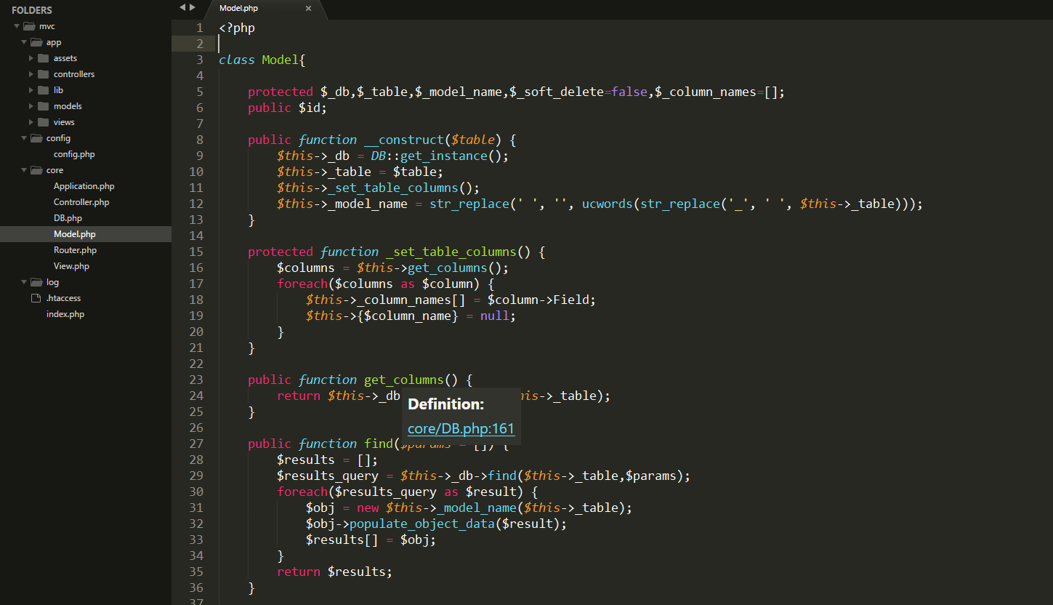
Core Classes

Slide 10
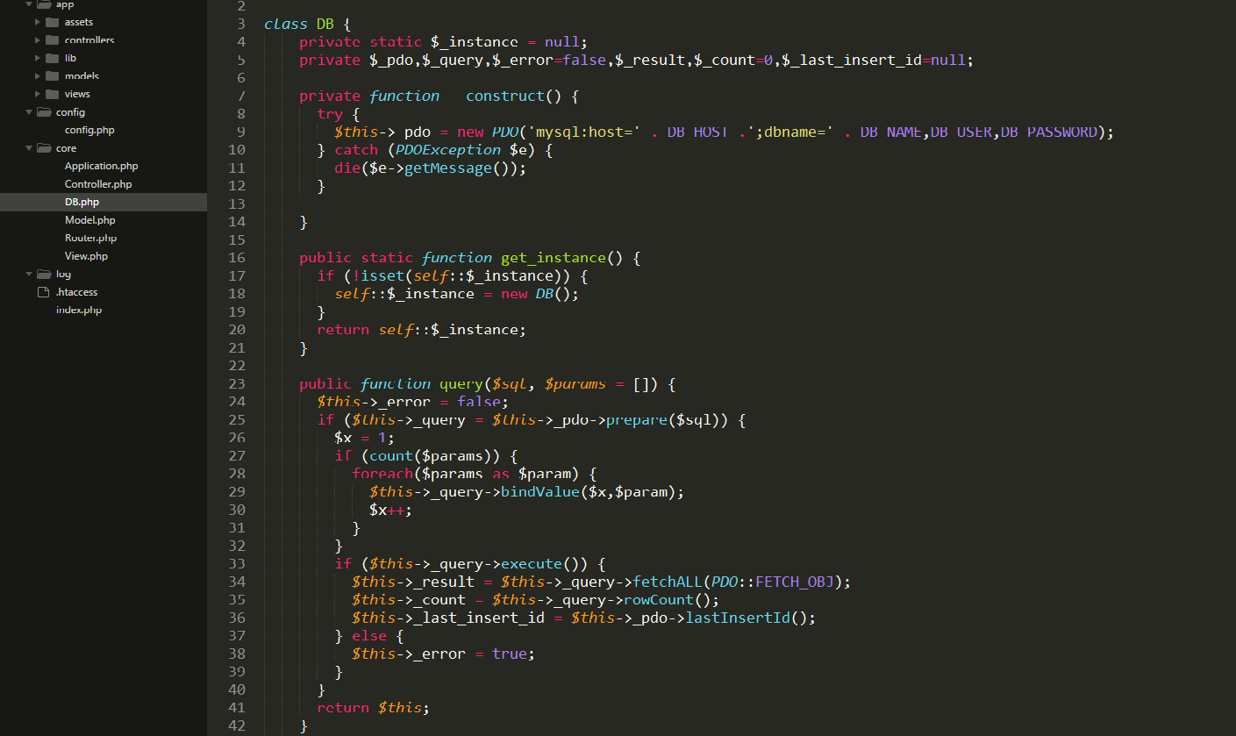

Slide 11
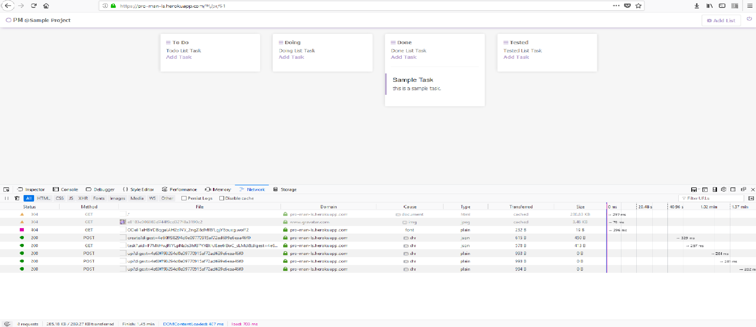
Sample Application and it’s performance on a free 512MB RAM server

Slide 12
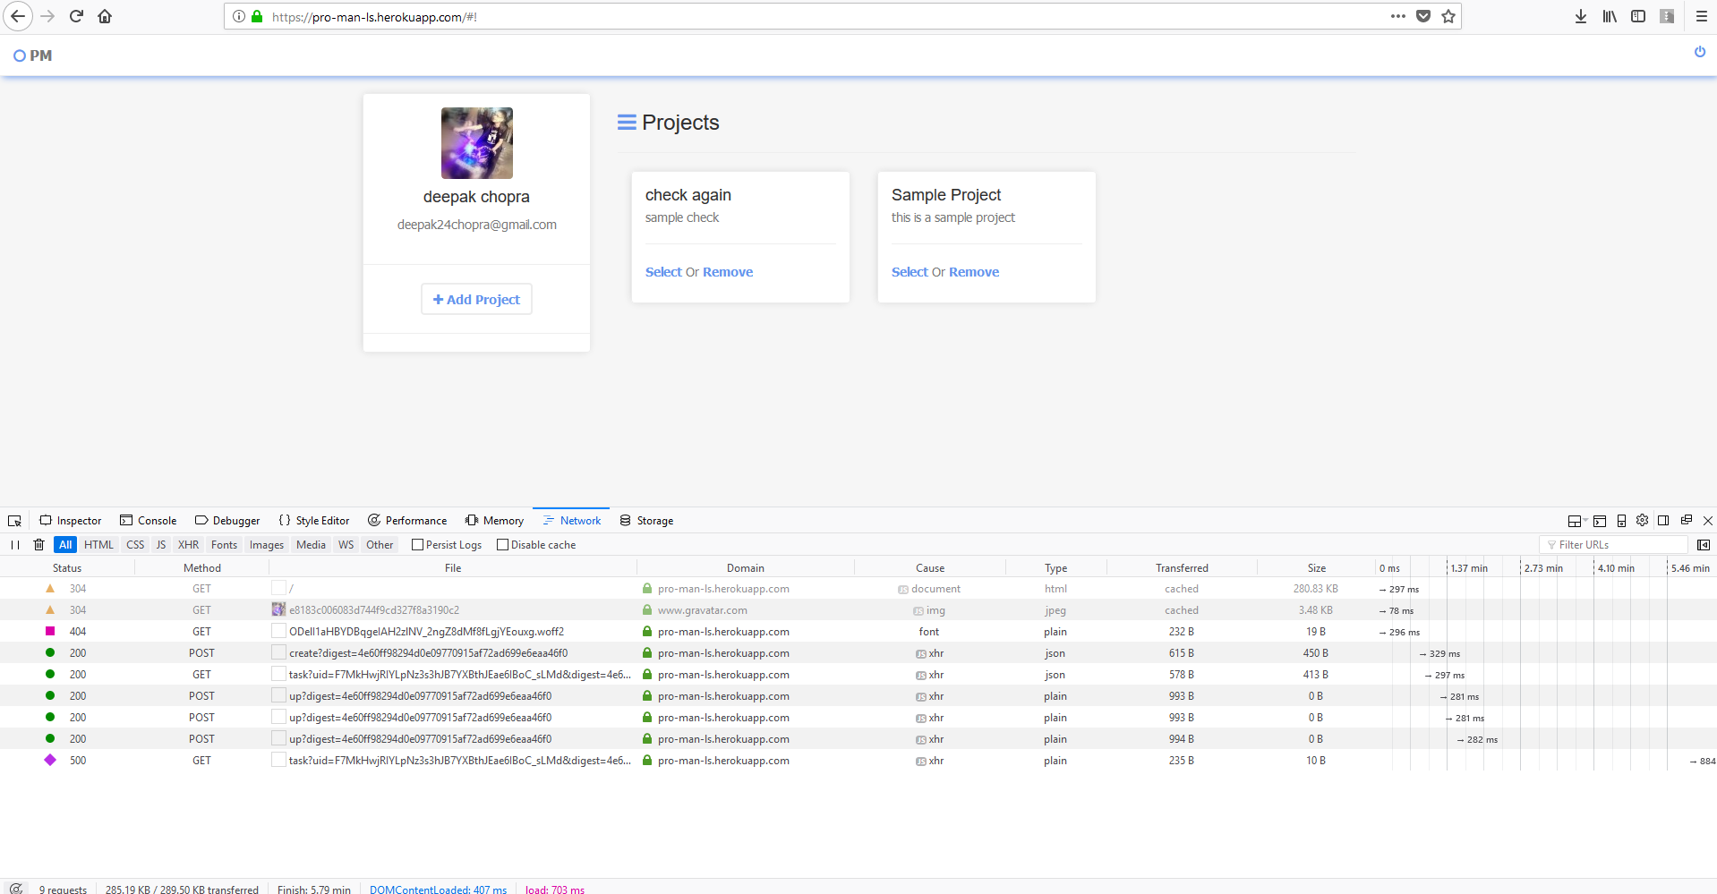

Slide 13
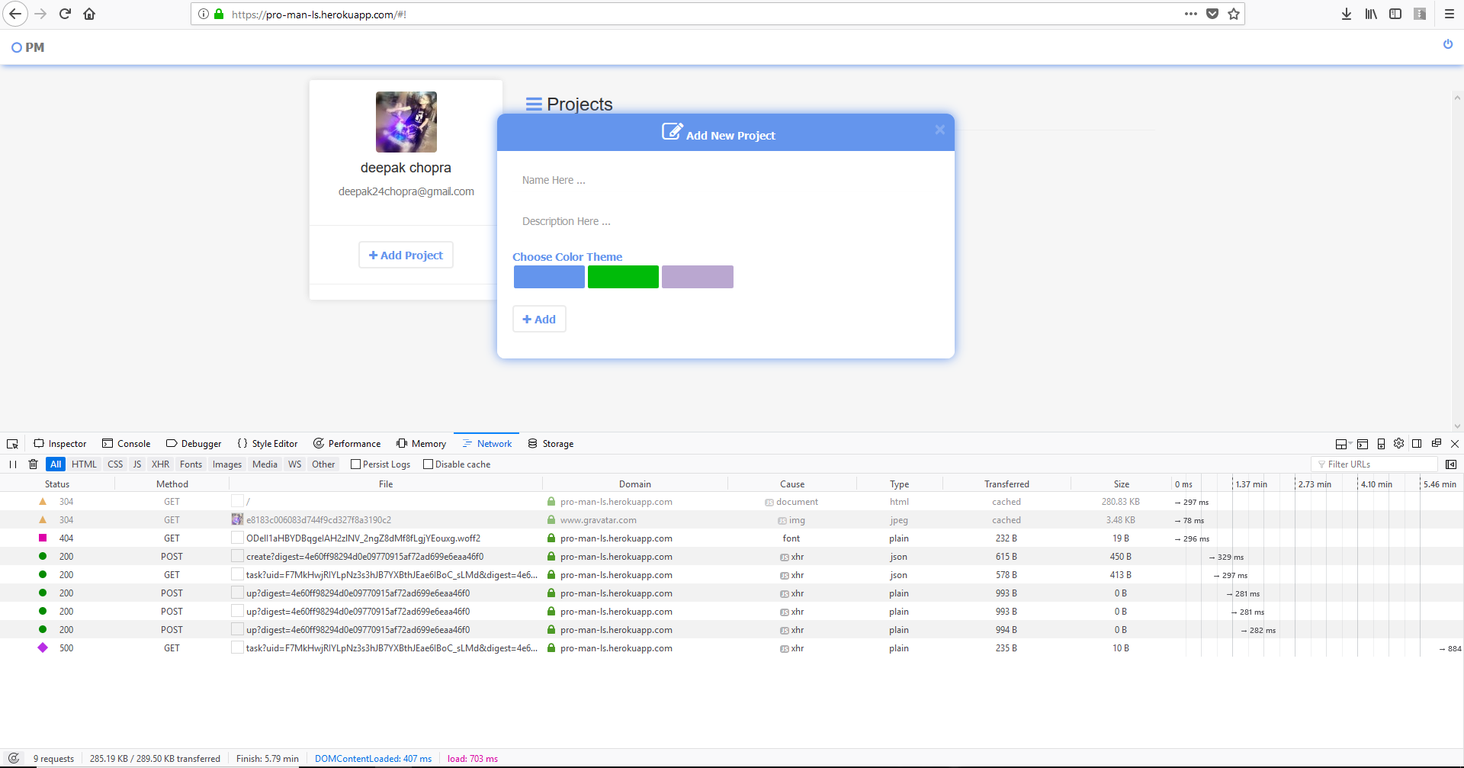

Slide 14
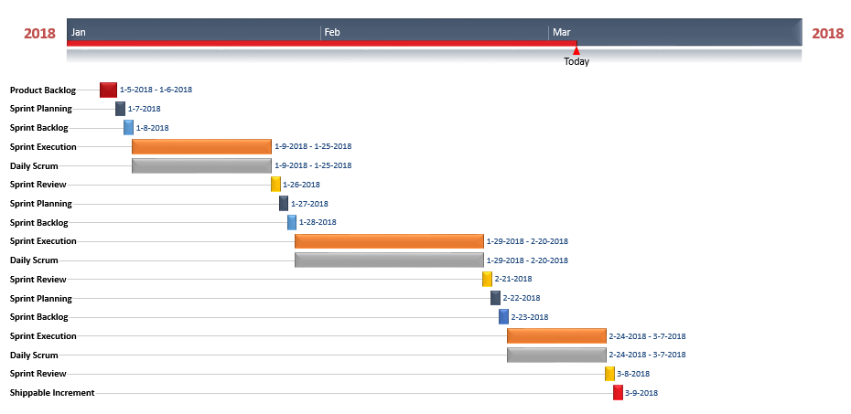
TIMEPLAN AND WORK COMPLETED

Slide 15
INDIVIDUAL WORK DONE
Ashish Kumar
Creating the full structure of the framework.
Writing the core files of controller, views and session which will be available in 2 version of the framework.
Creating the sample application on the framework and designing the frontend logic of the application .
Writing the helpers class, default functions class and validation class.
Will be providing the user interface to users to easily manage the resources and ram taken by the application.

Slide 16
Deepak Chopra
Creating the blueprint of the application.
Writing the core files of database, model and application class of the framework.
Session and request or data encryption class which will be available in 2 version of the framework.
Writing the backend logic of the sample application on the framework.
Writing further libraries to improve the functionality of the framework and making the framework more scalable.

Slide 17


